Slide 1
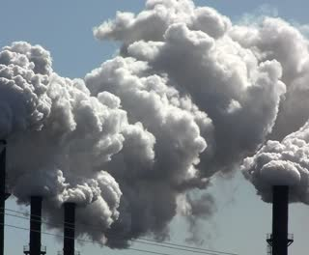

Air Quality Analysis and Prediction in Tamil Nadu

Slide 2
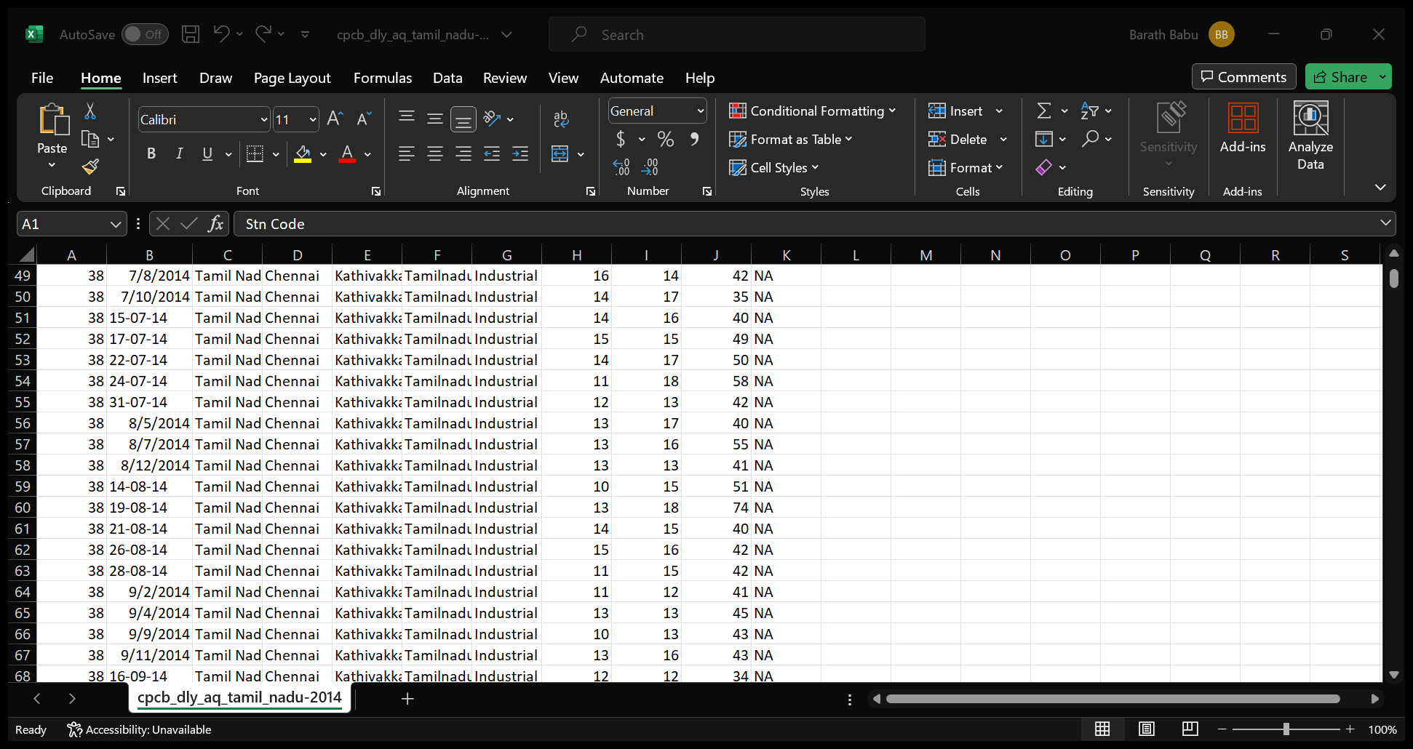
Project Definition:
To analyze and visualize air quality data from various monitoring stations in Tamil Nadu. The dataset you're working with contains measurements of Sulfur Dioxide (SO2), Nitrogen Dioxide (NO2), and Respirable Suspended Particulate Matter/Particulate Matter 10 (RSPM/PM10) levels in different locations. Here's a breakdown of the key components and goals of your project.
Data Analysis:
By making use of the link given below we can download the dataset for our project. https://tn.data.gov.in/resource/location-wise-daily-ambient-air-quality-tamil-nadu-year-2014

Slide 3
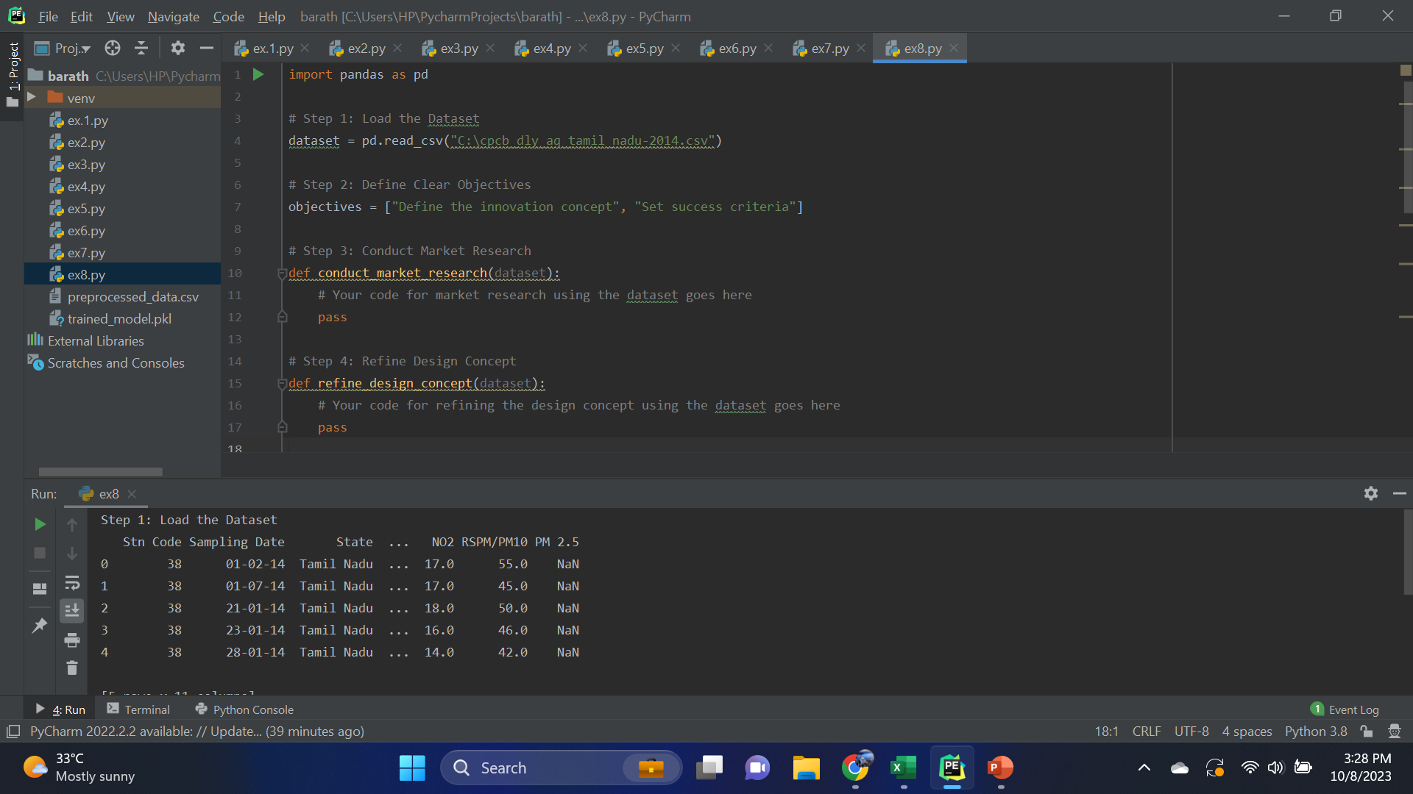
Air quality analysis and air quality index prediction: Collect historical air quality and meteorological data for the selected features. Preprocess the data by handling missing values and outliers.

Slide 4
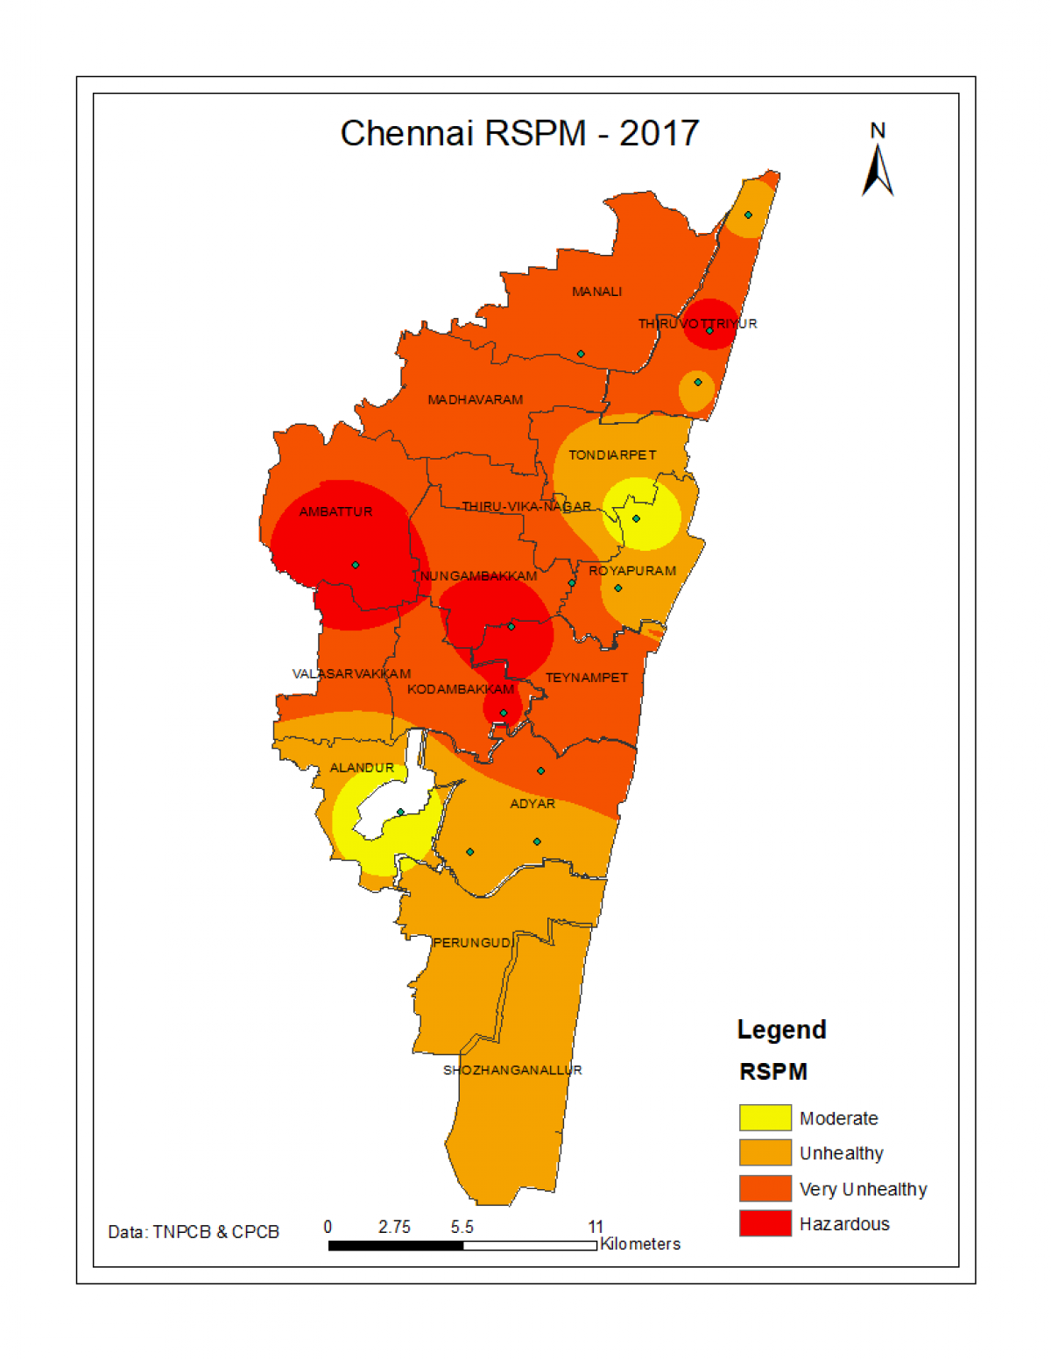
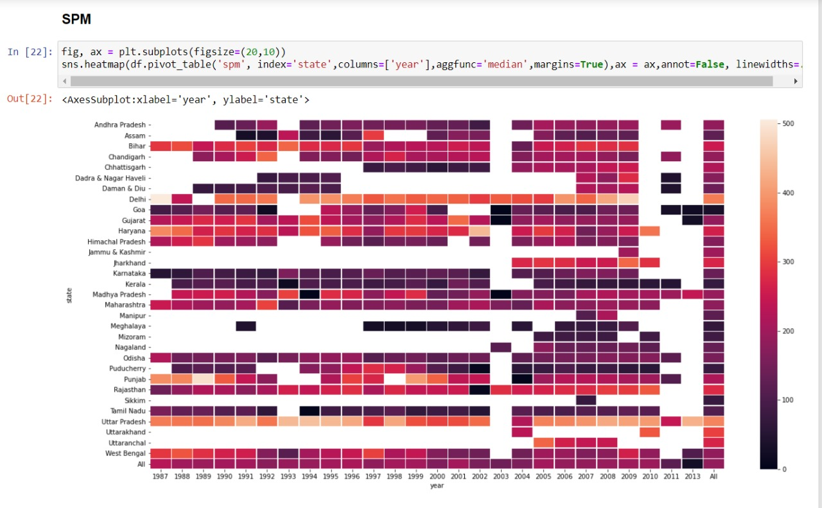
Location and hotspot of air quality analysis: Obtain air quality data for different monitoring stations in Tamil Nadu. This data should include information about pollutant concentrations (e.g., PM2.5, PM10, NO2, SO2) and the geographic coordinates (latitude and longitude) of each monitoring station.
heat map:

Slide 5
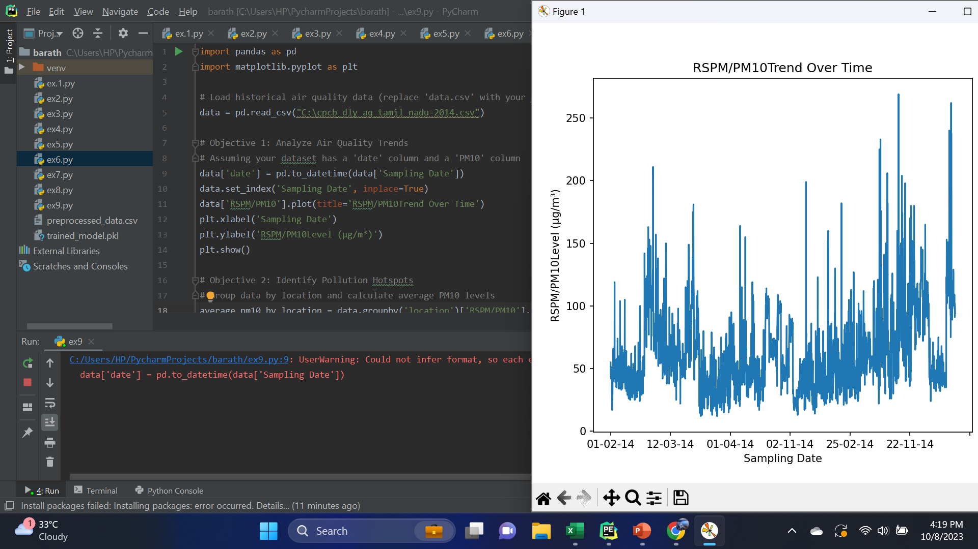
Air quality is a critical environmental concern that impacts public health and the overall well-being of communities. This project aims to address this concern by undertaking a comprehensive analysis of air quality data, identifying pollution hotspots, and building a predictive model for RSPM (Respirable Suspended Particulate Matter) or PM10 (Particulate Matter with a diameter of 10 micrometers or less) levels.

Slide 6
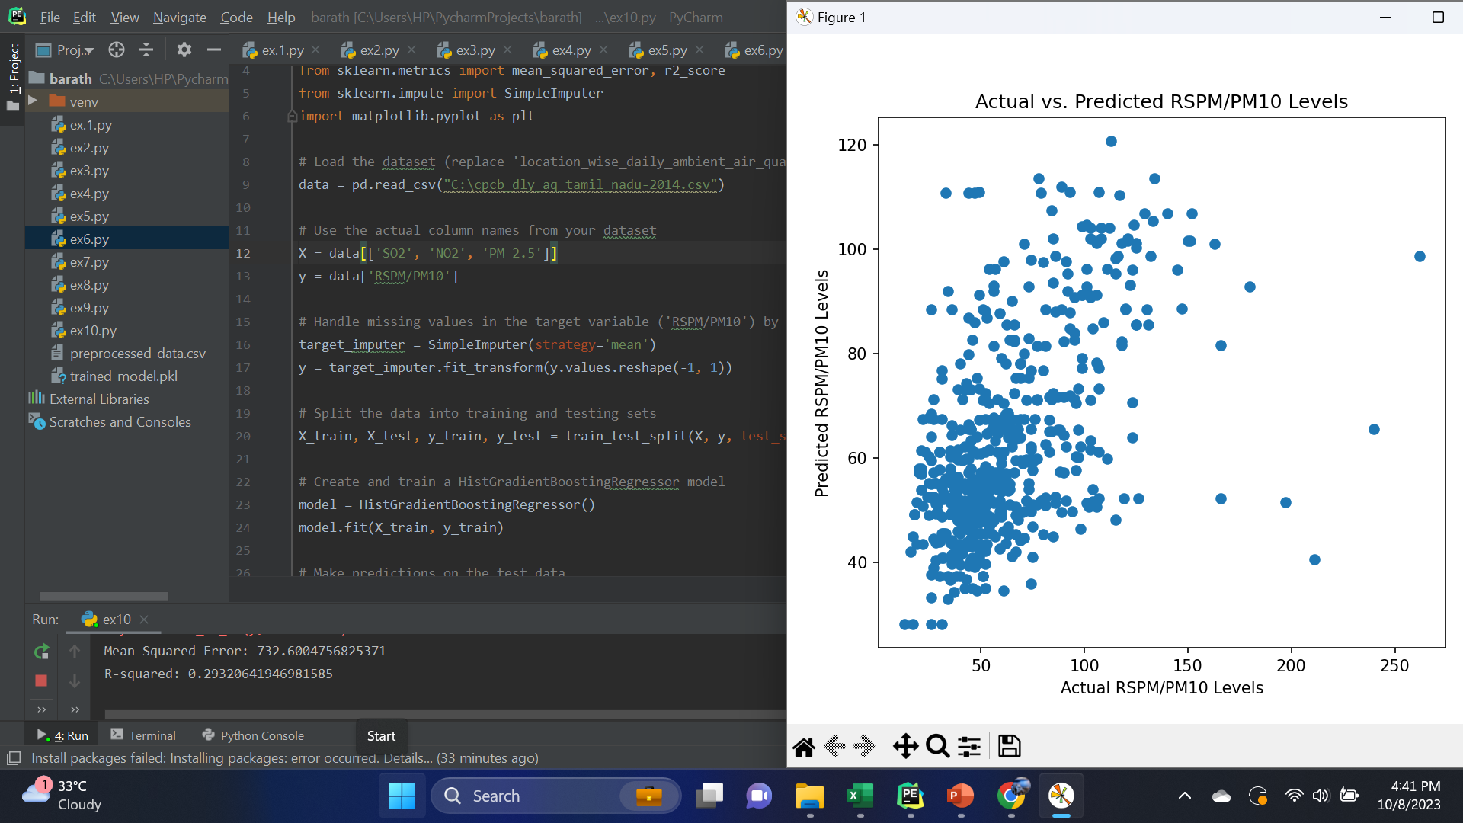
Advanced Predictive Modeling: One of the project's core components involves leveraging machine learning algorithms to build a highly accurate predictive model for RSPM/PM10 levels. This predictive model takes into account a wide range of environmental variables, such as weather conditions, traffic patterns, industrial activity, and historical air quality data. Machine learning algorithms, including regression models, decision trees, random forests, or even deep learning models like neural networks, are used to create this model. The model's accuracy is continually refined and validated against real-world data.

Slide 7

By our Team members

